Slide 1
Increasing Grantee and Subrecipient Capacity
NCDA 2021 Annual Conference
Marcy Esbjerg, MPA
Director
Pasco County, FL
mesbjerg@pascocountyfl.net

Slide 2
Pasco County
Population – 553,000 (just under 200,000 households)
Location – north of Tampa, FL on the Gulf of Mexico
Square Miles – 747
Owner-occupied/rental housing – 72%/28%
LMI – 40% LMI, 54% Cost Burdened
CDBG - $2.9 million
HOME - $1.2 million
ESG - $234,000
CDBG-CV 1st Tranche - $1.7 million
ESG-CV – 1st Tranche - $834,000
ESG- CV – 2nd Tranche - $3.8 million
CDBG-CV – 3rd Tranche - $1.996 million

Slide 3
What happens when your normal grant cycle goes from…

Slide 4
Or your work pace (and peace) goes from:

Slide 5
And The Money Keeps Coming
Three tranches of CV funds from HUD
CARES Act funding from the US Treasury distributed directly to the County
Coronavirus Relief Funds distributed from the Florida Housing Finance Corp. to Pasco County Community Development
Two rounds of Emergency Rental Assistance Program funds distributed directly to the County
Our department had to increase our capacity in order to deploy funds quickly and efficiently!
Four Strategies – What Worked and What Didn’t!
Call on a consultant.
All hands on deck.
Bring on/in the temps.
Farm it out to partner agencies.

Slide 6
Call A Consultant!
What Pasco Did: Established a contract with Florida Housing Coalition and the Homeless Coalition of Pasco County using CARES funding to assist with the program design for our ESG-CV funds, other agreements and RFP’s needed for homeless initiatives.
What Worked:
Knowledge and experience with
Coordinated Investment Plan
Comprehensive download of new HUD regulations and rules
Training
Written RFP’s, MOU’s, Agreements
Having an ‘outside’ expert to carry weight
Someone else to play the heavy
What Didn’t Work:
Not responsible for the outcome
Lack of inside/community knowledge
Support, once removed, didn’t leave lasting impact
Significant cost

Slide 7
All Hands On Deck!
What Pasco Did: For the first roll out of our direct financial assistance program, all Community Development team members (except CDBG/ESG staff) were required to keep a ‘client caseload’. Team members from other departments, whose departments had shuttered due to COVID, were also recruited.
What Worked:
Immediate increase in staffing numbers
Staff knew the County and internal people knew some of our processes
Level of control of information and process
Speed of roll out
What Didn’t Work:
High level of stress led to very low morale and resentment
Challenges with County payment process
Quality and quantity of workload inconsistent
Lack of control over other department personnel

Slide 8
Bring on/in the temps!
What Pasco Did: Both Community Development and Human Services worked with Human Resources to create a job description, advertise and hire over 15 temporary employees to work remotely and in the office to process financial assistance applications.
What Worked:
Relieved permanent staff to focus on regular work or other initiatives
Put people to work who had lost jobs when businesses closed
Remote work for those providing direct assistance
What Didn’t Work:
Temps needed extensive training
Front line staff in office left answering questions and updating applicants
Some temps could not handle the stress of the work and the mental anguish

Slide 9
Farm It Out to Partner Agencies!
What Pasco Did: An RFP to our community agencies with a short application period. Contracted with 7 agencies under CARES and 11 agencies under ERAP to deliver direct financial assistance.
What Worked:
Partner agencies are planted in the community. Outreach is their core mission.
Advancing their funding on a monthly basis.
Maintain strict reporting /monitoring requirements.
Training, FAQ’s, standard forms, processes and procedures
Using HMIS for duplication of benefits
What Didn’t Work:
Agencies ‘following the money’ but not in their wheelhouse
Even with advanced funding, some agencies did not have funding to float
Disconnect between agency management and frontline staff providing direct assistance
First month monitoring could have been more comprehensive

Slide 10
Overall Lessons Learned
Protect your team and their morale
Understand the difference between temporary increased capacity and long- term capacity building
Monthly monitoring implemented
Follow your contract
Value and cultivate internal and external relationships
City/County departments
Partner agencies
Consultants

Slide 11
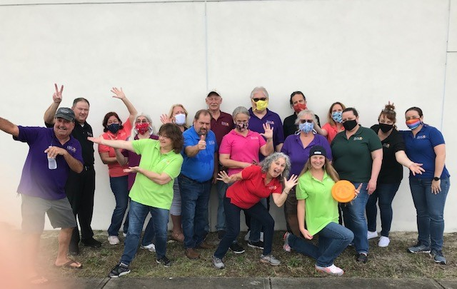
Questions?
Mission
Improving the lives of Pasco’s citizens through homeless initiatives, neighborhood revitalization, affordable housing and community partnerships using state and federal funding.
Notes:
XXX17-XXXX P1 Slide 3 of 4 Kim Styles

